Slide 1
Recommendation Systems
Content-Based Recommendations
Collaborative Filtering
Hybrid Systems
Professor Wei-Min Shen
University of Southern California
Thanks for source slides and material to:
J. Leskovec, A. Rajaraman, J. Ullman: Mining of Massive Datasets
http://www.mmds.org

Slide 2
Additional Reading
Overview articles: Wikipedia pages on Recommender Systems and Collaborative Filtering:
http://en.wikipedia.org/wiki/Recommender_system
http://en.wikipedia.org/wiki/Collaborative_filtering
Motivation: Article on The Long Tail
http://www.wired.com/wired/archive/12.10/tail.html
Recommender Systems, Prem Melville and Vikas Sindhwani, Encyclopedia of Machine Learning, 2010
http://www.prem-melville.com/publications/recommender-systems-eml2010.pdf
A Survey of Collaborative Filtering Techniques
http://dl.acm.org/citation.cfm?id=1722966

Slide 3
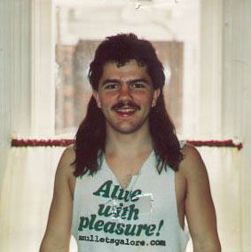
Example: Recommender Systems
Customer X
Buys Metallica CD
Buys Megadeth CD
Customer Y
Does search on Metallica
Recommender system suggests Megadeth from data collected about customer X

Slide 4











Recommendations
Examples:
Search
Recommendations
Items
Products, web sites, blogs, news items, …

Slide 5
Motivation: The Long Tail

Slide 6
From Scarcity to Abundance
Shelf space is a scarce commodity for traditional retailers
Also: TV networks, movie theaters,…
Web enables near-zero-cost dissemination of information about products
From scarcity to abundance
More choice necessitates better filters
Recommendation engines
How Into Thin Air made Touching the Void a bestseller: http://www.wired.com/wired/archive/12.10/tail.html
Notes:
In 1988, a British mountain climber named Joe Simpson wrote a book called Touching the Void, a harrowing account of near death in the Peruvian Andes. It got good reviews but, only a modest success, it was soon forgotten. Then, a decade later, a strange thing happened. Jon Krakauer wroteInto Thin Air, another book about a mountain-climbing tragedy, which became a publishing sensation. SuddenlyTouching the Void started to sell again.
Random House rushed out a new edition to keep up with demand. Booksellers began to promote it next to their Into Thin Air displays, and sales rose further. A revised paperback edition, which came out in January, spent 14 weeks on theNew York Times bestseller list. That same month, IFC Films released a docudrama of the story to critical acclaim. NowTouching the Void outsells Into Thin Air more than two to one.
What happened? In short, Amazon.com recommendations. The online bookseller's software noted patterns in buying behavior and suggested that readers who liked Into Thin Airwould also like Touching the Void. People took the suggestion, agreed wholeheartedly, wrote rhapsodic reviews. More sales, more algorithm-fueled recommendations, and the positive feedback loop kicked in.

Slide 7
Touching the Void
In 1988, Joe Simpson wrote a book called Touching the Void, a harrowing account of near death in the Peruvian Andes.
It got only a modest success, it was soon forgotten.
A decade later, Jon Krakauer wrote Into Thin Air, another book about a mountain-climbing tragedy
which became a publishing sensation.
Suddenly Touching the Void started to sell again.
Now Touching the Void outsells Into Thin Air more than two to one.
Notes:
What happened? In short, Amazon.com recommendations. The online bookseller's software noted patterns in buying behavior and suggested that readers who liked Into Thin Airwould also like Touching the Void. People took the suggestion, agreed wholeheartedly, wrote rhapsodic reviews. More sales, more algorithm-fueled recommendations, and the positive feedback loop kicked in.

Slide 8
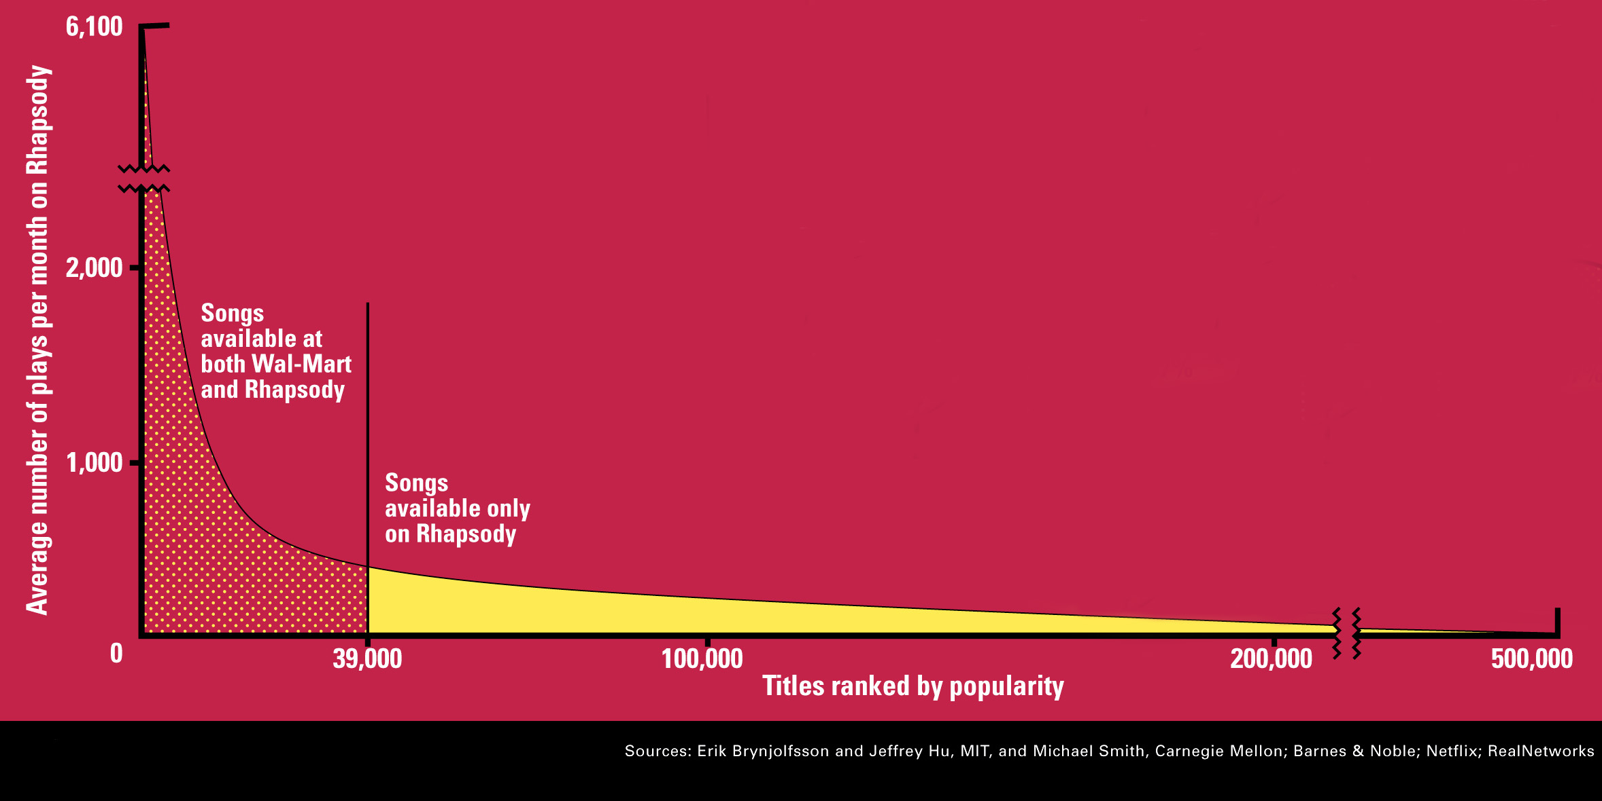
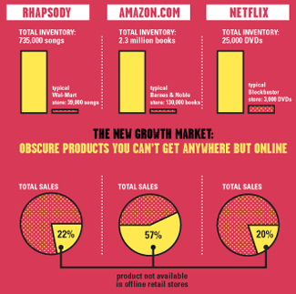
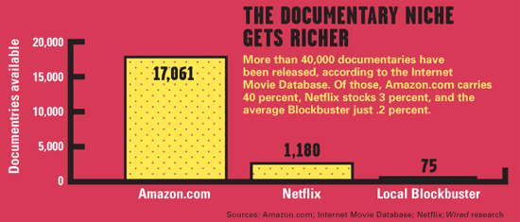
The Long Tail
Source: Chris Anderson (2004)

Slide 9
Change in thinking compared with online stores
"What percentage of the top 10,000 titles in any online media store (Netflix, iTunes, Amazon, or any other) will rent or sell at least once a month?"
Most people guess 20 percent
80-20 rule, also known as Pareto's principle (1896)
Only 20 percent of major studio films, TV shows, books, etc. will be hits
The right answer: 99 percent
Demand for nearly every one of those top 10,000 titles

Slide 10
Counterintuitive to old way of thinking
The 20 percent rule in the entertainment industry is about hits, not sales of any sort
Hit-driven mindset: think that if something isn't a hit, it won't make money
Makes sense with scarce shelf space in a retail store
iTunes, Amazon, and Netflix: discovered that "misses" usually make money, too
And because there are so many more of them, that money can add up quickly to a huge new market
Industry has a poor sense of what people want
Turns out that people like a wide range of things when they are easily available

Slide 11
Rules of thumb
Rule 1: Make everything available
Embrace underserved markets, niches (e.g., obscure video genres)
What matters is not where customers are, or how many of them are seeking a particular title, but that some number of them exist, anywhere
As a result, almost anything is worth offering on the chance it will find a buyer
Example:
“Put it on the craiglist!”
“One man’s junk is another’s treasure”!

Slide 12
Rules of thumb (cont.)
Rule 2: Lower costs
Have taken away the unnecessary costs of the retail channel: manufacturing, distribution, and retail overheads
Leaves the costs of finding, making, and marketing content
Ensure that the people on the creative and business side still make money
Rule 3: Help users find new content, easily
Edited recommendations
Content-based recommendations
Collaborative filtering: uses browsing and purchasing patterns of users to guide those who follow them
"Customers who bought this also bought ...”
Use recommendations to drive demand down the Long Tail

Slide 13
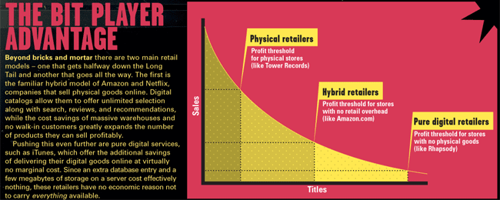
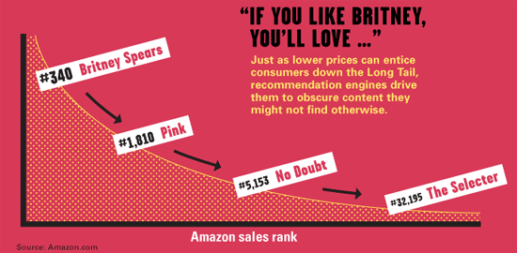
Physical vs. Online
http://www.wired.com/wired/archive/12.10/tail.html

Slide 14
Types of Recommendations

Slide 15
Types of Recommendations
Editorial and hand curated
List of favorites
Lists of “essential” items
Simple aggregates
Top 10, Most Popular, Recent Uploads
Tailored to individual users
Amazon, Netflix, …

Slide 16
Formal Model
X = set of Customers
S = set of Items
Users have preferences for certain items
Want to extract preferences from data
Utility function u: X × S => R
R = set of ratings
R is a totally ordered set
e.g., 0-5 stars, real number in [0,1]
Notes:
If X is totally ordered under ≤, then the following statements hold for all a, b and c in X:
If a ≤ b and b ≤ a then a = b (antisymmetry);
If a ≤ b and b ≤ c then a ≤ c (transitivity);
a ≤ b or b ≤ a (totality).

Slide 17
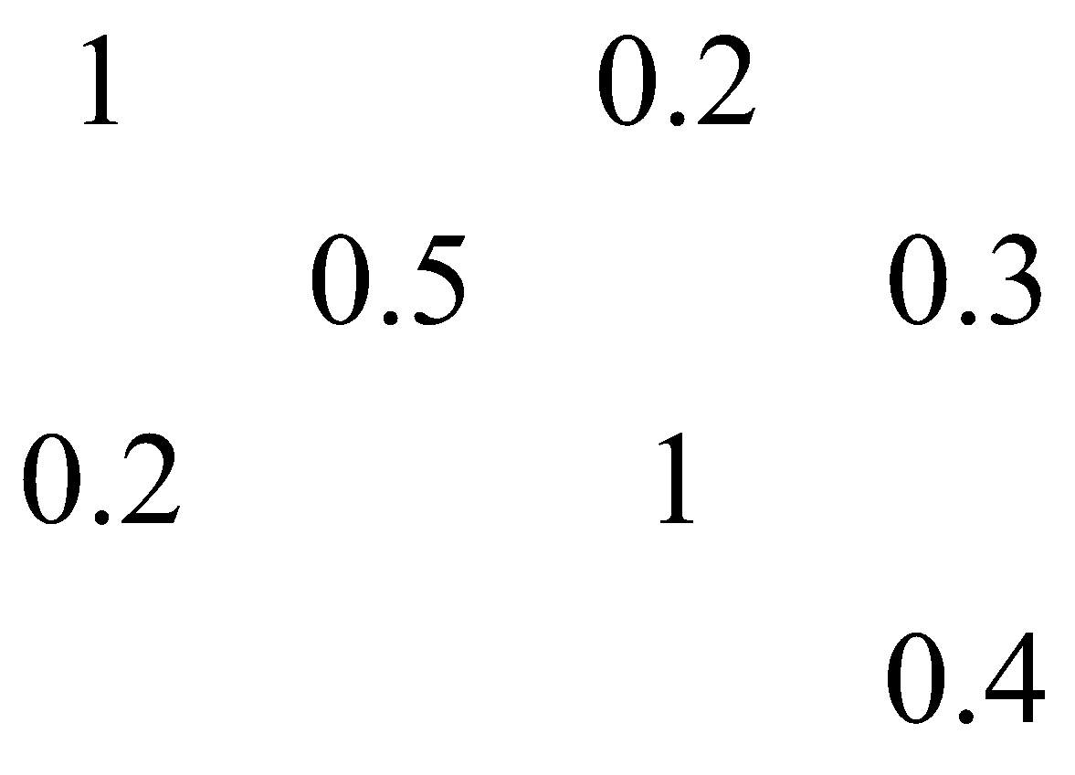
Utility Matrix
For each user-item pair, value represents degree of preference of that user for that item (e.g., rating)
Matrix is sparse (most entries unknown)
S
Avatar
LOTR
Matrix
Pirates
Alice
Bob
X
Carol
David

Slide 18
Predictions
Goal of a Recommendation System is to predict the blanks in the utility matrix
Would Alice like Pirates?
Would David like Avatar?
Not necessary to predict every blank entry
Want to discover some entries in each row that are likely to be high
Usually recommend a few items the user should value highly
Most likely to generate additional revenue

Slide 19
Key Problems
(1) Gathering “known” ratings for matrix
How to collect the data in the utility matrix
(2) Extrapolate unknown ratings from the known ones
Mainly interested in high unknown ratings
We are not interested in knowing what you don’t like but what you like
To generate revenue
(3) Evaluating extrapolation methods
How to measure success/performance of recommendation methods

Slide 20
(1) Gathering Ratings
Explicit
Ask people to rate items
Doesn’t work well in practice – people can’t be bothered
Implicit
Learn ratings from user actions
E.g., purchase implies high rating
What about low ratings?

Slide 21
(2) Extrapolating Utilities
Key problem: Utility matrix U is sparse
Most people have not rated most items
Cold start:
New items have no ratings
New users have no history
How to extrapolate missing entries?

Slide 22
Three Approaches to Recommendation Systems
1) Content-based
Use characteristics of an item
Recommend items that have similar content to items user liked in the past
Or items that match predefined attributes of the user
2) Collaborative filtering
Build a model from a user's past behavior (items previously purchased or rated) and similar decisions made by other users
Use the model to predict items that the user may like
Collaborative: suggestions made to a user utilize information across the entire user base
3) Hybrid approaches
Notes:
201603w1.1

Slide 23
Content-based Recommender Systems

Slide 24
Content-based Recommendations (Item-based or user-based)
Main idea: Recommend items to customer x that are similar to previous items rated highly by x
Requires characterizing the content of items in some way
Examples:
Movie recommendations
Recommend movies with same actor(s), director, genre, …
Websites, blogs, news
Recommend other sites with “similar” content

Slide 25
Plan of Action
Item profiles
likes
build
recommend
match
Red
Circles
Triangles
User profile

Slide 26
General Strategy for Content-Based Recommendations
Construct item profiles (item-based)
Explicit features in a database, discovering features in documents, Tags
Create vectors representing items
Boolean vectors indicate occurrence of high TF.IDF word
Numerical vectors might contain ratings
Construct user profiles (user-based)
Create vectors with same components that describe user’s preferences
Recommend items to users based on content
Calculate cosine distance between item and user vectors
Classification algorithms

Slide 27
Content-Based Recommendation
Item-i profile vector
User-U profile vector
Item-j profile vector
Item i is more similar to user U then j
Recommend i to U

Slide 28
ITEM PROFILES

Slide 29

Item Profiles
For each item, create an item profile
Profile is a set (vector) of features
Movies “features”: screenwriter, title, actor, director,…
Text “features”: Set of “important” words in document
Example 9.2
Features of movies: a set of (8) actors, and an average rating
E.g., see table below, each movie has 5 actors, two in both movies
Average ratings 3 and 4 (with unknown scaling factor α)
Must scale non-Boolean components so they are not dominant or irrelevant
Actors (features)
Rating
Movies (Items)
Notes:
201601 first

Slide 30
Cosine Distance (Section 3.5.4)
Cosine distance is used in spaces with dimensions, including Euclidean spaces
Where points are vectors with integer or Boolean components
Points thought of as directions
Cosine distance between 2 points is the angle that the vectors to those points make
Range from 0 to 180 degrees
First compute cosine of the angle between vectors x and y
Then apply arc-cosine function to translate to 0-180 degrees: the cosine distance
Notes:
2018 w1.1

Slide 31
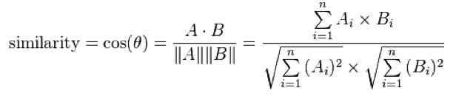

Cosine Similarity (Used to Calculate Cosine Distance)
Dot product x.y divided by Euclidean distance of x and y from origin (Section 3.5.2)
Dot product of vectors:
Euclidean distance of two vectors x, y

Slide 32
Example 3.1.3: Cosine Distance
x = [1,2,-1] y = [2,1,1]
Dot product x.y = 1x2 + 2x1 + (-1)x1 = 3
Euclidean distance of two vectors x, y
Euclidean distance of a vector from the origin: vector for origin is all zeros
Distance of x from origin is:
Distance of y from origin also sqrt(6)
Cosine of angle from x to y is
Arccosine of ½ is 60 degrees
That is the cosine distance between x and y

Slide 33

Back to Item Profiles Example (9.2)
Features of movies are set of actors and average rating (scaled)
Dot product of these two item vectors is:
Or
Distance from origin using
Lengths of vectors (distance from origin) are:
Cosine of angle between vectors is
Scaling factor alpha affects how similar items are
Notes:
2017 01 w1

Slide 34
ITEM PROFILES BASED ON TEXTUAL CONTENT

Slide 35
Item Profiles based on Textual Content
Much research on content-based recommendations focuses on textual content
Recommend items (web pages, books, movies) based on associated textual content
Descriptions, user reviews
Can treat this as an Information Retrieval task (IR)
How to identify whether two documents are about similar things?
How to pick important features of documents?
Want to identify the significant words in documents

Slide 36
TF.IDF: Measure of Word Importance
Classification of documents as being about similar things starts with finding significant words in those documents
Not most frequent words
(the, and, a, …) – called “stop words”
Not just rare words either
Want concentration of useful words in just a few documents
Usual heuristic from text mining is TF-IDF: (Term frequency * Inverse Doc Frequency)
Words with highest TF.IDF score are often the terms that best characterize the topic of a document
When constructing an item profile for Recommender system:
Document … Item
Term … Feature

Slide 37
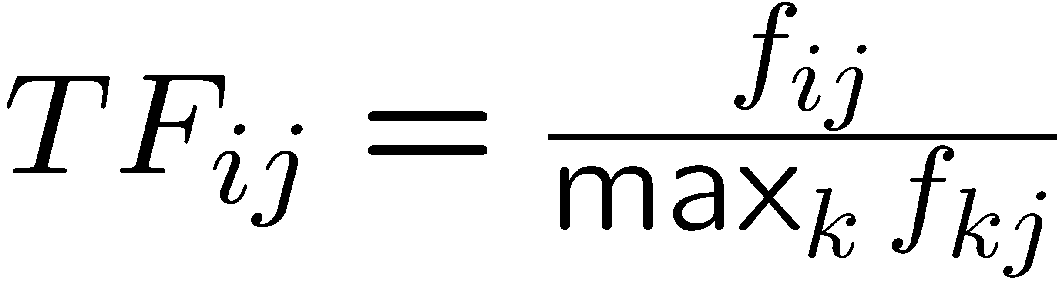

TF-IDF: From Section 1.3.1 (Term frequency * Inverse Document Frequency)
f_{ij} = frequency of term (feature) i in document (item) j
Term frequency of term i in document j is normalized
Divide by maximum occurrences of any term in document j
Most frequent term has TF=1
n_{i} = number of docs that mention term i
N = total number of docs
TF-IDF score: w_{ij} = TF_{ij} × IDF_{i}
Item profile for a document = set of words with highest TF-IDF scores, together with their scores
Term Frequency:
Inverse Document Frequency:
Notes:
why do we take log of variables

Slide 38
TF.IDF Example (Example 1.3)
Repository of 2²⁰ = 1,048,576 documents
Suppose word w appears in 2¹⁰ = 1024 documents
Inverse document frequency:
IDF_{w} = log₂(2²⁰/2¹⁰) = log₂(2¹⁰) = 10 (logarithm scaled)
Consider document j in which word w appears 20 times
Assume that this is the maximum number of times any word appears in document j (after eliminating stop words)
So TF_{wj} = 1
TF.IFD score for w in document j is 1*10=10
Consider document k where word w appears once
Maximum number of occurrences of any word in k is 20
So TF_{wk} = 1/20
TF.IDF score for w in document k is (1/20)*10=1/2
j k
w 10 0.5

Slide 39
Recommender Systems: Make Recommendations Based on Features of Documents
Want to suggest articles, pages, blogs a user might want to see
Hard to classify items by topic
In practice, try to identify words that characterize the topic of a document
Eliminate stop words: several hundred most common words
For remaining words, calculate the TF.IDF score for each word in the document
The words with the highest TF.IDF scores characterize the document

Slide 40
Represent documents by a set of words
Take as features of the document the n words with highest TF.IDF scores
Could pick same n for all documents
Or let n be fixed percentage of words in the document
Could also make all words with TF.IDF scores above a given threshold are part of feature set
Documents then represented by set of ”important” words
Expect these words to express subjects or main ideas of documents
Then can measure the similarity of two documents using:
Cosine distance between the sets, treated as vectors (last time)
Jaccard distance (Ch. 3) between sets of word

Slide 41
Document Similarity using Cosine Distance
First compute cosine of the angle between vectors A and B
Then apply arc-cosine function to translate to 0-180 degrees: the cosine distance

Slide 42
Recall: Item Profiles Example (9.2)
Features of movies are set of actors and average rating (scaled)
Dot product of these two item vectors is:
Or
Distance from origin using
Lengths of vectors (distance from origin) are:
Cosine of angle between vectors is

Slide 43
Document Similarity using Cosine Distance
Think of set of high-TF.IDF words as a vector, with one component for each possible word
Vector has 1 if word is in the set for that document, 0 if not
Between two documents, only a finite number of words among their two sets
Almost all components are 0; do not affect dot product
Dot products are size of intersection of the two sets of words
Lengths of vectors are square roots of number of words in each set
Cosine of angle between vectors: dot product divided by product of vector lengths

Slide 44
Document Similarity: Two Kinds
Chapter 3: find nearly-identical (similar) documents
Lexical similarity: Documents are similar if they contain large fraction of identical sequences of characters
Shingling: convert documents to sets
Minhashing: convert large sets to short signatures, preserving similarity
Locality-sensitive hashing (LSH): Focus on parts of signatures likely to be from similar documents to identify candidate pairs
For Recommendation Systems (Chapter 9):
Interested in occurrences of many important words in both documents (even if little lexical similarity between documents)
Similar methodology:
High TF.IDF words form a vector, with a component for each possible word set to 1 or 0 (analogous to sets of shingles)
Based on a distance measure (Jaccard or cosine distance)
Notes:
Based on a distance measure (Jaccard or cosine distance)
Use minhashing or random hyperplanes (Section 3.7.2)
Feed data into LSH to find pairs of documents that share many common keywords

Slide 45
Another Option to Describe Item Content: Obtaining Item Profile Features from Tagging Systems
Useful for content-based recommendations for images
E.g., Flickr photosharing, Facebook, Instagram, Snapchat
Users enter words or phrases that describe items
GPS information/geofilters: e.g., automatically add location information when a photo is uploaded
Can use tags as a recommendation system
E.g., if user retrieves or bookmarks pages with certain tags, recommend other pages with same tags
Only works if users create tags or allow automatic geotagging

Slide 46
Item Profile (Summary)
Items = ?
Features or components of items = ?
Distance between items = ?
features
Items

Slide 47
USER PROFILE

Slide 48
General Strategy for Content-Based Recommendations
Construct item profiles
Source we discussed:
Explicit features in a database
Discovering features in documents
Tags
Create vectors representing items
Boolean vectors indicate occurrence of high TF.IDF word
Numerical vectors might contain ratings
Construct user profiles
Create vectors with same components that describe user’s preferences
Recommend items to users based on content
Calculate cosine distance between item and user vectors
Classification algorithms

Slide 49
User Profiles (Examples 9.3 and 9.4)
Construct user profiles
Create vectors with same components that describe user’s preferences
Best estimate regarding which items a user likes is some aggregation of the profiles of those items
User profile possibilities:
Boolean utility matrix: average the components of vectors representing item profiles for the items in which utility matrix has a 1 for that user
E.g., 20% of movies that user U likes have actor A (has a 1)
User profile for U will have 0.2 in component for actor A
Non-boolean utility matrix: (e.g., ratings) weight the vectors representing profiles of items by utility (rating) value
U gives average rating of 3; rates three movies with actor A: 3, 4, 5
Normalize by subtracting user’s average rating: new ratings 0, 1, 2
Then user profile component for actor A will have value of 1
Negative weights for below-average ratings, positive for above-avg.
Notes:
201601 second
2016w1.2
2018 w1.2

Slide 50
Content-Based Recommendations
Prediction Heuristic
Given user profile x and item profile i
Estimate degree to which a user would prefer an item by computing cosine distance between x and i vectors
Classification Algorithms
Use machine learning techniques
Regard given data as a training set
For each user, build a classifier that predicts the rating of all items
Ratings on a scale of 1 to k can be directly mapped to k classes
Many different classifiers
Naïve Bayes classifier
K-nearest neighbor
Decision trees
Neural networks

Slide 51
Example 9.5
Building User Profile in Previous Example (9.4):
U gives average rating of 3; rates three movies with actor A: 3, 4, 5
Normalize by subtracting user’s average rating: new ratings 0, 1, 2
Negative weights for below-average ratings, positive for above-average
Movie with many actors the user likes:
Cosine of angle will be large positive fraction
After applying the arccosine, will have a small cosine distance between vectors (angle close to 0 degrees)
Movie with mix of actors the user likes/doesn’t like: Cosine of angle will be around 0 (angle close to 90 degrees)
Movie with many actors user doesn’t like: Cosine will be a large negative fraction => large cosine distance between vectors (angle close to 180 degrees)

Slide 52
Thought Exercise
Actors (features)
Rating
Item
Profile
Movie1 Movie2
User
Profile
User U .1 .5 .7 .1 .4 .7 .1 .6
User V .2 .8 .1 .9 .2 .9 .7 .1
Which movie should we recommend for user U and V?
distance(Movie1, UserU) = ?
distance(Movie2, UserU) = ?
distance(Movie1, UserV) = ?
distance(Movie2, UserV) = ?

Slide 53
Recommending items based on cosine distance
Estimate degree to which a user would prefer an item by computing cosine distance between x and i vectors
Scale components with values that are not boolean (e.g., ratings)
Use Random hyperplanes (RH) and Locality Sensitive Hashing (LSH) techniques to place item profiles (i vectors) in buckets
For a given user (x vector), apply RH and LSH techniques: identify in which bucket we look for items that might have a small cosine distance from user

Slide 54
DECISION TREES

Slide 55
Example 9.6: Decision Trees
Items are news articles
Features are high TF.IDF words (keywords) in these documents
Suppose user U likes articles about baseball except articles about New York Yankees
Row of utility matrix for U has a 1 if U has read the article, blank otherwise
Construct decision tree:
select a predicate for each interior node
Classify an item:
Start at root and apply predicate to the item
If predicate is true, go to left child; if false, go to right child
Repeat until a leaf is reached: leaf classified liked or not liked

Slide 56
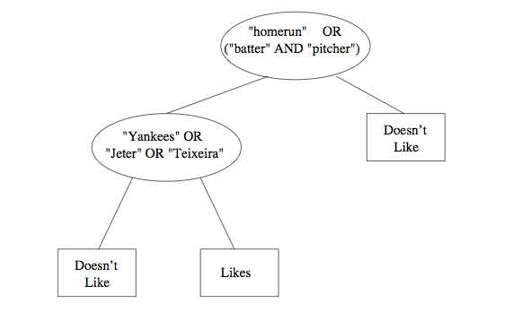
Example 9.6 (cont.)

Slide 57
Classifiers
Classifiers of all types take a long time to construct
E.g., for decision trees: need one tree per user
Constructing a tree requires looking at all item profiles
Have to consider many different predicates
Could involve complex combinations of features
Typically applied only to small problem sizes

Slide 58
SUMMARY OF CONTENT-BASED APPROACH

Slide 59
Pros: Content-based Approach
+: No need for data on other users
No cold-start (for item) or sparsity problems (i.e., new items can receive recommendations)
+: Able to recommend to users with unique tastes
+: Able to recommend new & unpopular items
No first-rater problem (i.e., new products never have been rated, therefore they cannot be recommended)
+: Able to provide explanations
Can provide explanations of recommended items by listing content-features that caused an item to be recommended
Notes:
First-rater problem: new products never have been rated, therefore they cannot be recommended
Cold-Start problem: new users cannot receive recommendations since they have no evaluations about products

Slide 60
Cons: Content-based Approach
–: Finding the appropriate features is hard
E.g., images, movies, music
–: Recommendations for new users
How to build a user profile?
–: Overspecialization
Never recommends items outside user’s content profile
People might have multiple interests
Unable to exploit quality judgments of other users (don’t use ratings!)

